Slide 1

Game Maths & Physics
Vectors
Part 2
Basic operations on vectors

Slide 2

Basic vector operations and properties
Addition/Subtraction
Magnitude
Normalisation
Multiplication by a scalar
Mario Planet exercise

Slide 3


Vector addition
b
a
Addition of two vectors
a + b
c
d
Addition of many vectors
b
a
a + b + c + d

Slide 4
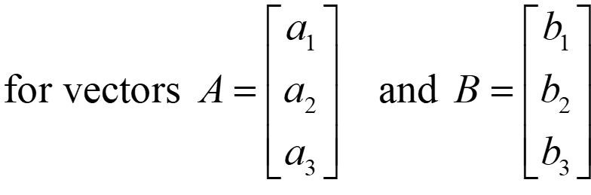
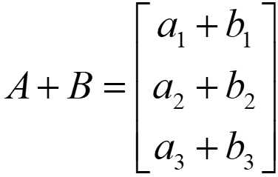
Vector addition
Numerically:

Slide 5
Vector addition
Find C + D given
C=[2 3]
D=[-3 5]
C + D = [2 + -3 3 + 5]
= [-1 8]
y
C+D (-1, 8)
D (-3, 5)
D (-3, 5)
C (2, 3)
x

Slide 6
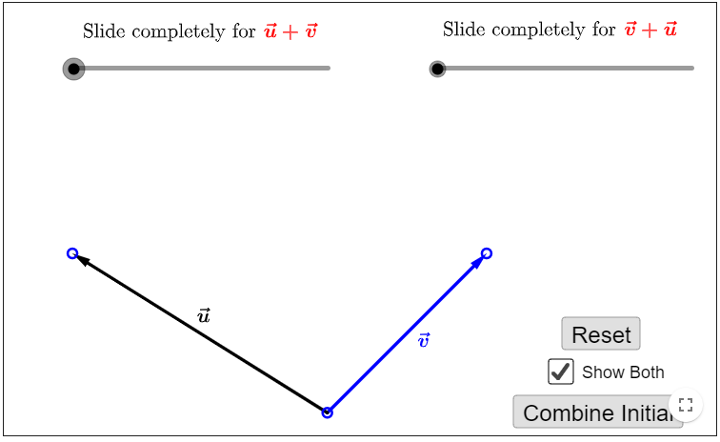
Vector addition
Let’s try this out interactively
https://www.geogebra.org/m/ty53wFpP

Slide 7
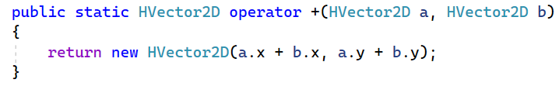
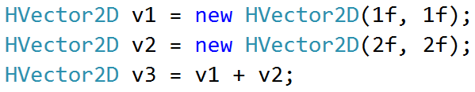
Vector addition
Operator overloading for +
This allows you write code like this:
A class that you will write later
You should be able to figure out vector subtraction!

Slide 8
Vector subtraction
a - b
-b
b
a
a + b
Starting Position

Slide 9
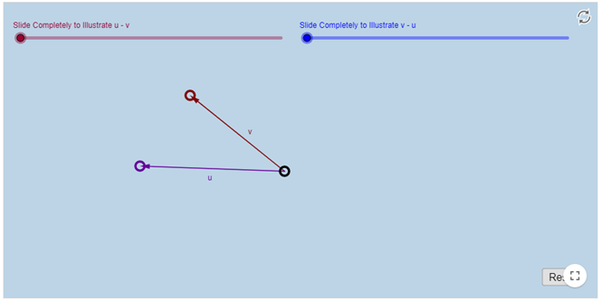
Vector subtraction
-b
https://www.geogebra.org/m/thkzrnqa
b
a + (-b)
a
Starting Position

Slide 10
Vector subtraction
Start Point
A
How to find AB?
B
End Point
+B
Origin
-A
A
B
= B-A
A point can be defined by a vector with its tail at the origin
Remember, vectors have no position!

Slide 11
Vector magnitude/length
||v|| indicates length or magnitude of v
If ||v|| is 1, v is a unit vector
2D
3D

Slide 12
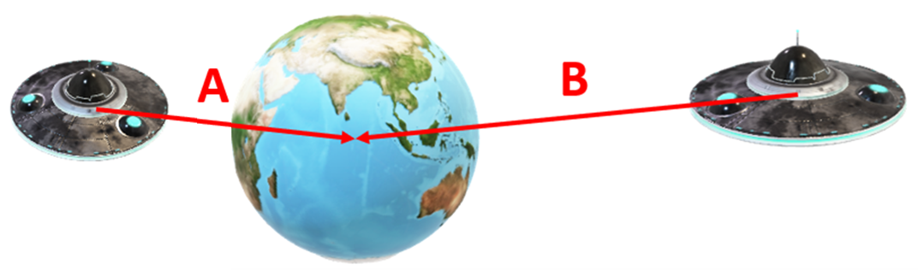
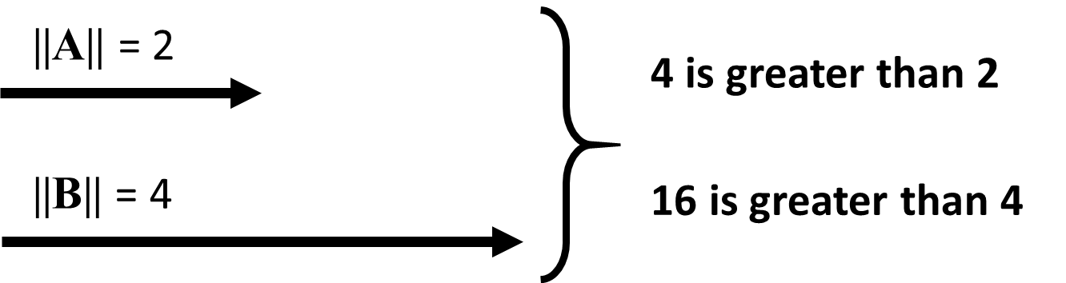
Vector magnitude/length
Usually compare length squared
Why?
The square root operation is expensive!
But unless you compare 1000s of vectors it won’t make any real difference these days!

Slide 13
Vector normalisation
A small “hat” is used to identify unit vectors
A vector has 2 components:
Magnitude
Direction
^
^
^
i j k
We won’t do that here, because it isn’t easy to add the hat every time!
To normalize a vector is to turn it into a unit vector:
Magnitude: 1 unit
Direction: same direction
Important when we only want to deal with direction, and where magnitude would distort the calculation results (eg: facing direction)

Slide 14
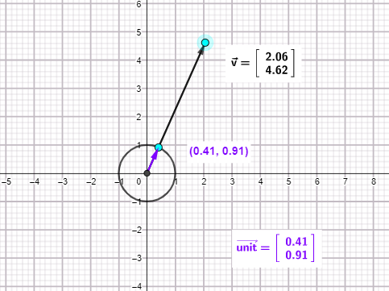
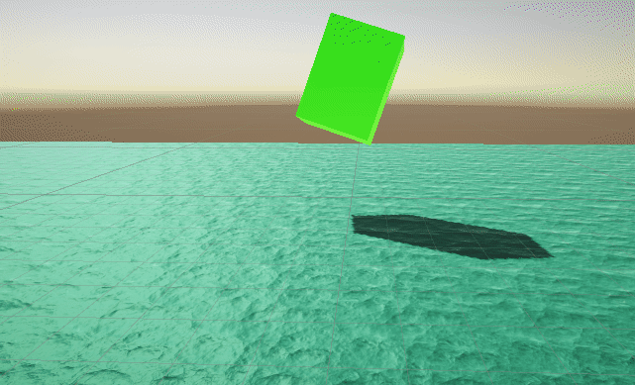
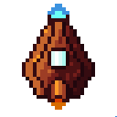

Vector normalisation
In games, we often need to know the direction of a vector, but not its magnitude.
We then normalise the direction vector to obtain a unit vector in that direction.
Can you think of an example?
https://www.geogebra.org/m/zgsgqdvs
Fire a missile with a certain speed at a target
Buoyancy
direction vector
unit vector
In this case, speed is 2
unit vector * speed
We’ll look at this in more detail when we talk about kinematics
Forces are applied in various directions to keep the object afloat

Slide 15
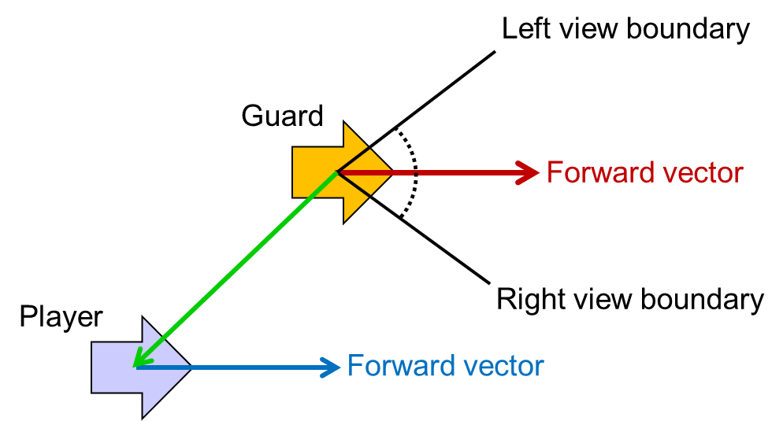
Vector normalisation
The angle between two vectors, can be found using the dot product (we’ll discuss this later).
It is much easier and faster to do this if the vectors are first normalized (change in magnitude does not change direction).
Check viewing angle
Dot product of green and red vectors
Both must be unit vectors
angle

Slide 16
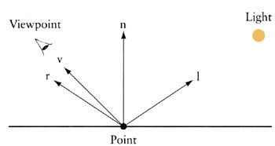
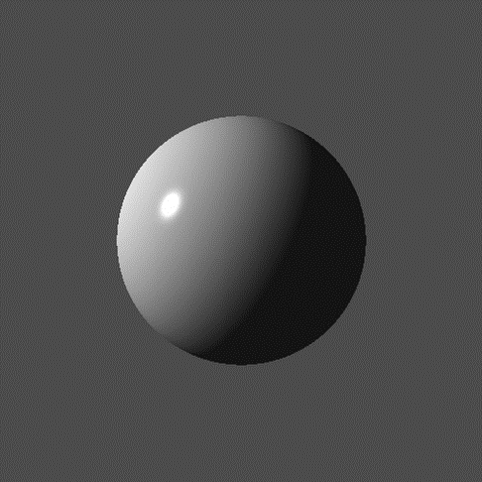
Vector normalisation
Another application is in computer graphics shading.
The surface normal must be a unit vector.

Slide 17
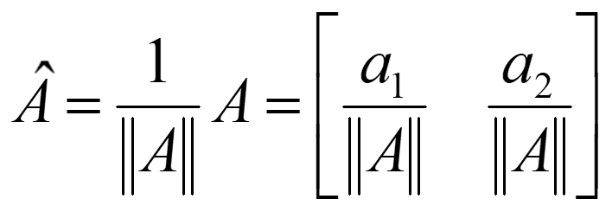
Vector normalisation
In 2D, normalized vector A =
for any vector A = [a₁ a₂]
magnitude of A
To normalize a vector, calculate the magnitude of the vector and then divide each component by the magnitude

Slide 18
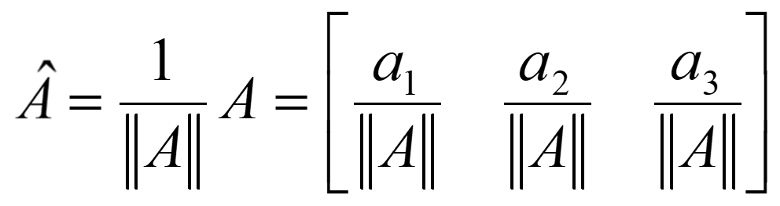
Vector normalisation
In 3D, normalized vector A =
Example
Normalize the vector A = [3 0 -4]
Magnitude of A =
Normalized vector A =

Slide 19
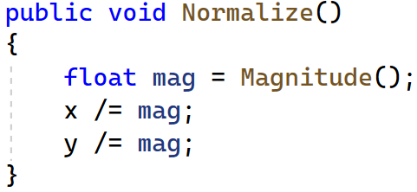
Vector normalisation
The function we looked at a few slides ago

Slide 20
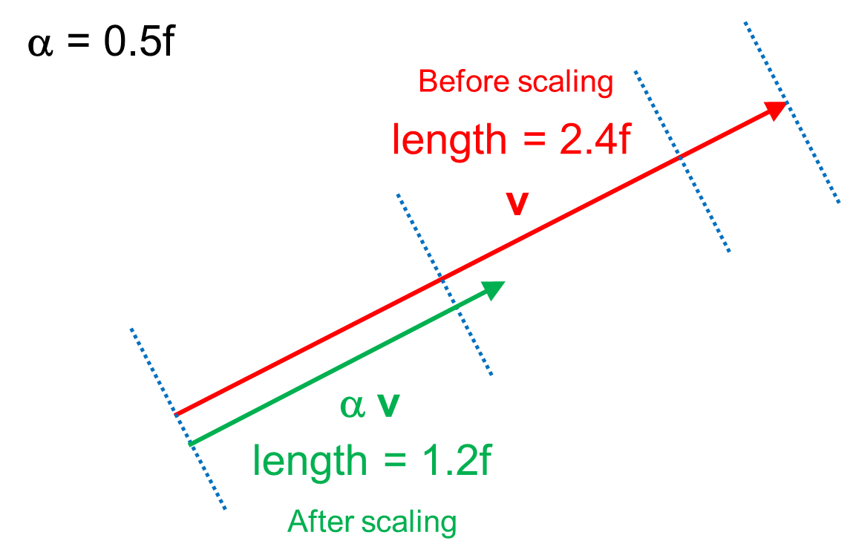
Vector multiplication by a scalar
Change the length of vector v by α

Slide 21
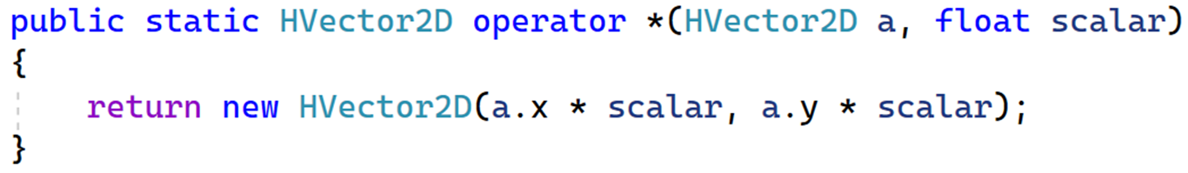
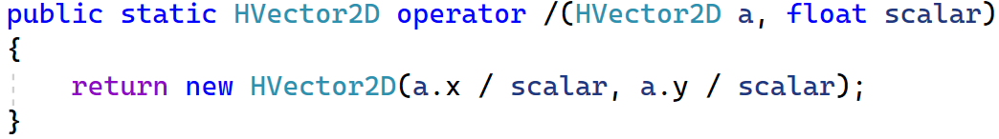
Vector multiplication by a scalar
Negative vector
v
Multiply by -1.0f
Same Magnitude
Directly opposite
-v

Slide 22

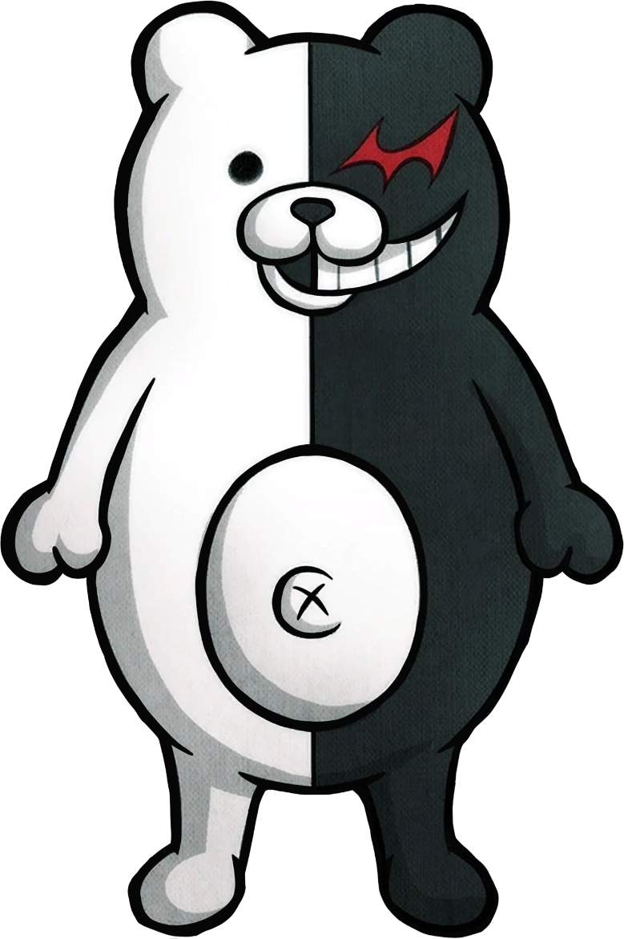
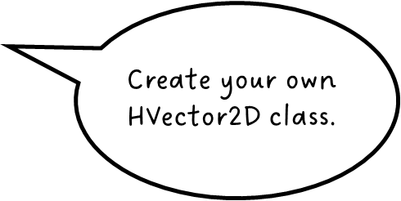
Now do Question 3 in your worksheet!

Slide 23
QUESTION 3 - Review
Any questions?
https://tinyurl.com/3r4k9m62

Slide 24
I’m back sooner than you thought!
Now do question 4!

Slide 25
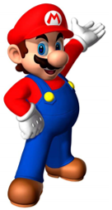
QUESTION 4 - Review
Mario
Mario’s move vector is perpendicular to the gravity vector
move vector
gravity vector
gravity vector
move vector
So, if we know the gravity vector, how can we calculate the move vector (for 2D)?

Slide 26
(-x, -y) → (-y, x)
Find the normalised vector parallel to gravity, then flip it to move clockwise and multiply by speed.
Normalise the gravity vector so that it can be multiplied by gravityStrength.
x
b
normalised gravity vector
a
perpendicular
normalised vector * gravityStrength
-y
-y
normalised
final gravity vector
-x
flipped
This shows how if gravity were reversed, there would be no need to flip the move vector (to move clockwise)
(x, y) → (y, -x)
Normalise the move vector so that it can be multiplied by speed.
+y
normalised
Here, the tail is at the center, and the head is at the surface
perpendicular
for speed = 3
a
b
-x
+y
+x

Slide 27
Perpendicular vectors b for various vectors a
b
a
-x
+y
+x
-y

Slide 28
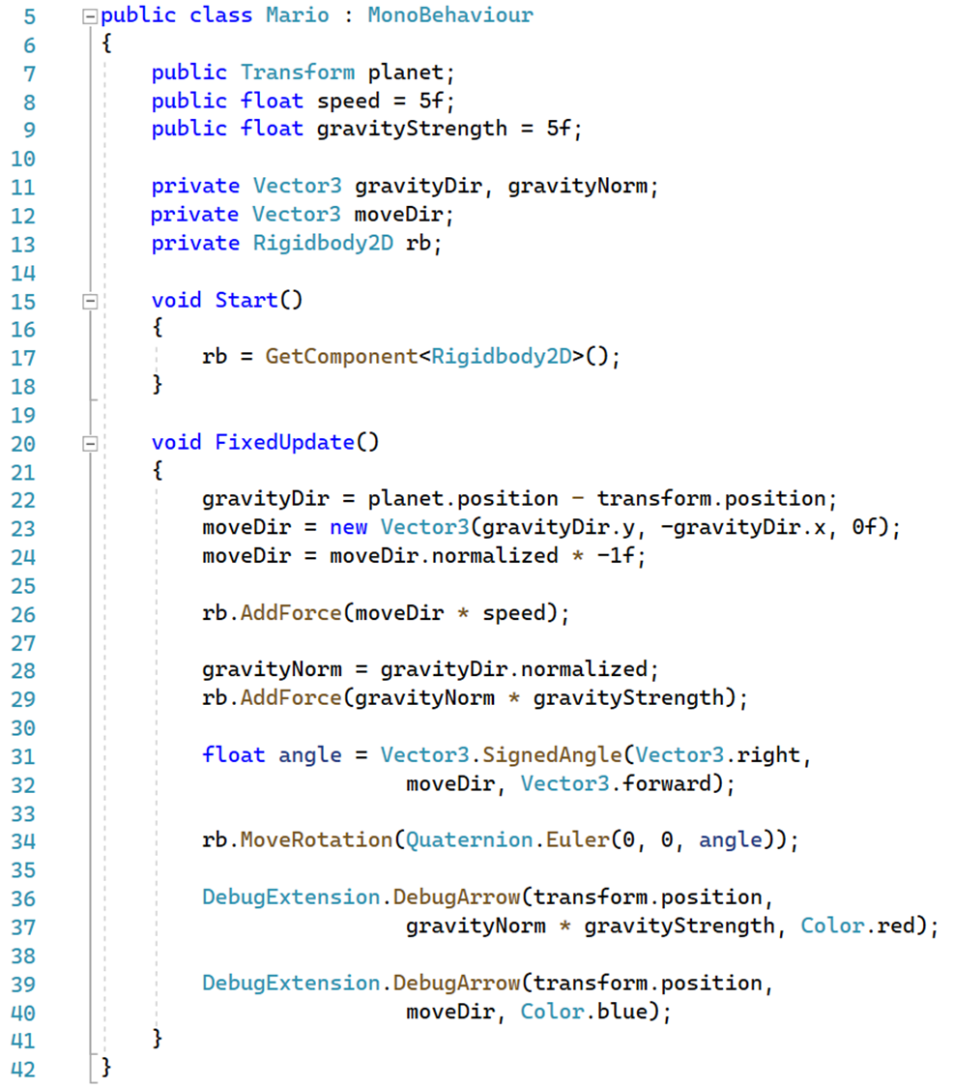

Slide 30
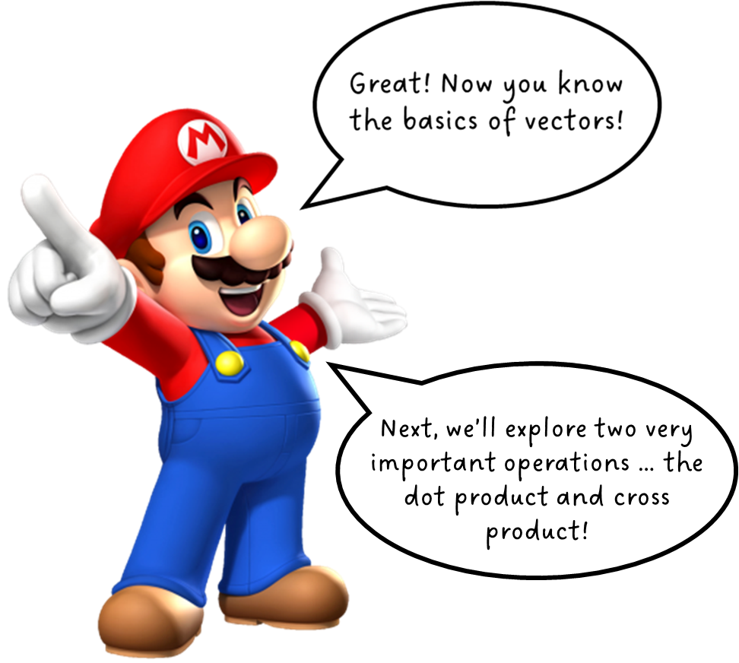
Great! Now you know the basics of vectors.
You also know the basics of simple vector operations. You’ll find that these are used all the time in games programming!

Slide 31


